Slide 1
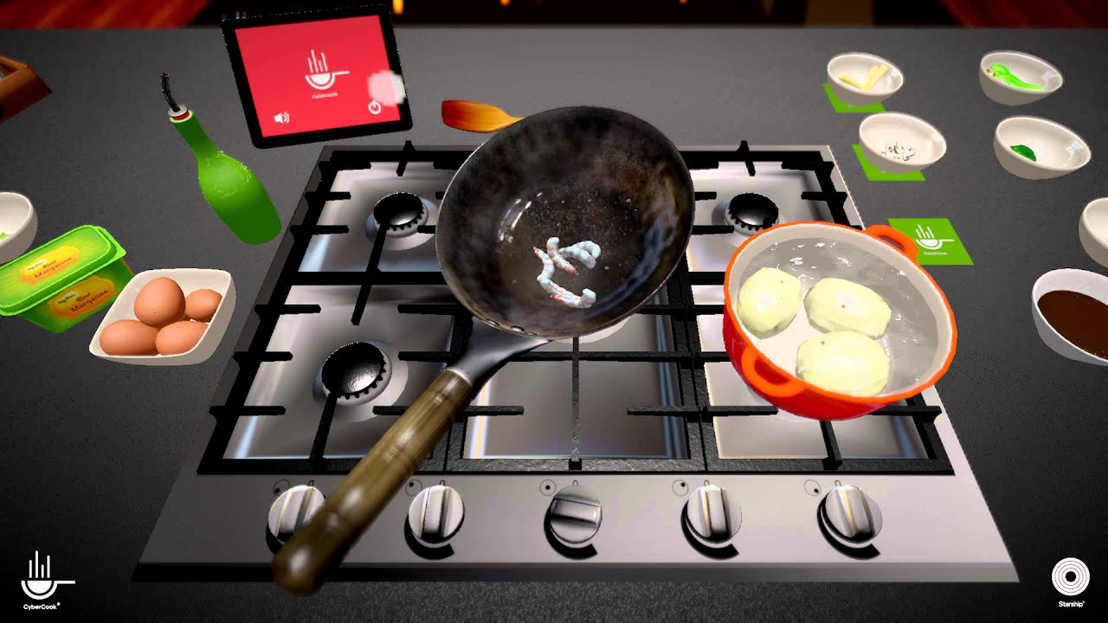
CRAZY COOK-OFF
The Next-Level in a Family Competitive Arcade

Slide 2
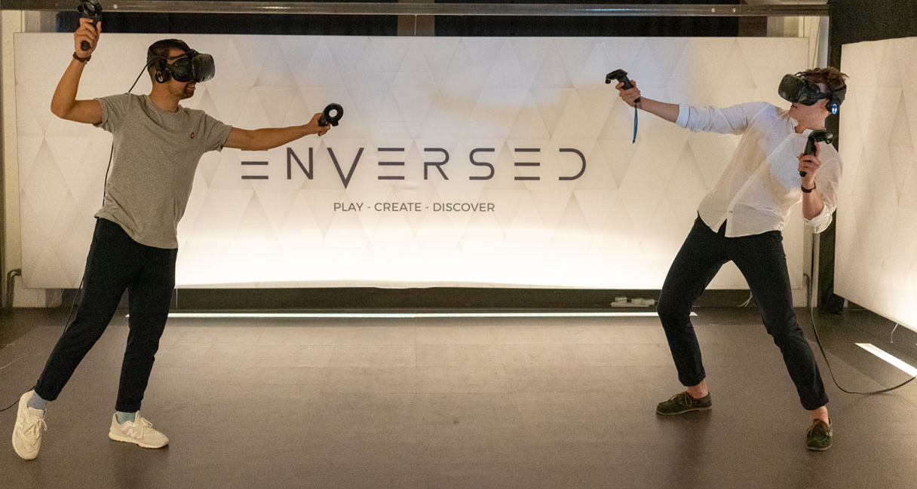
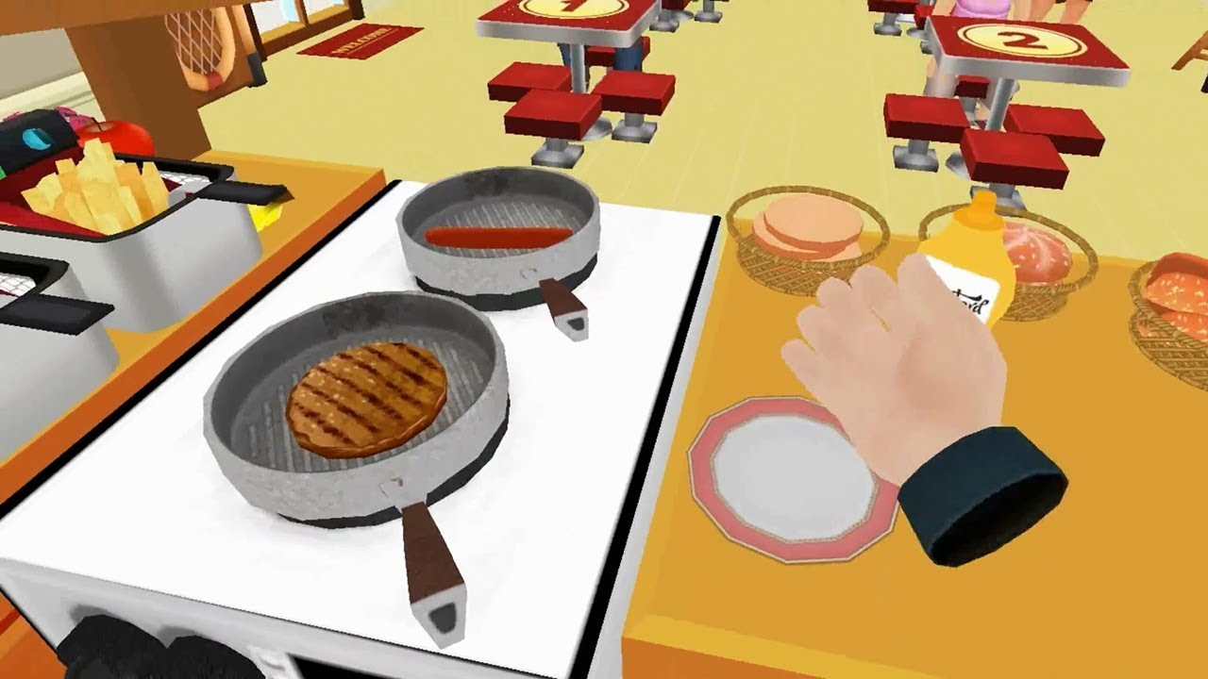
What is crazy cook-off?
First Person
VR
Competitive Action Arcade

Slide 3

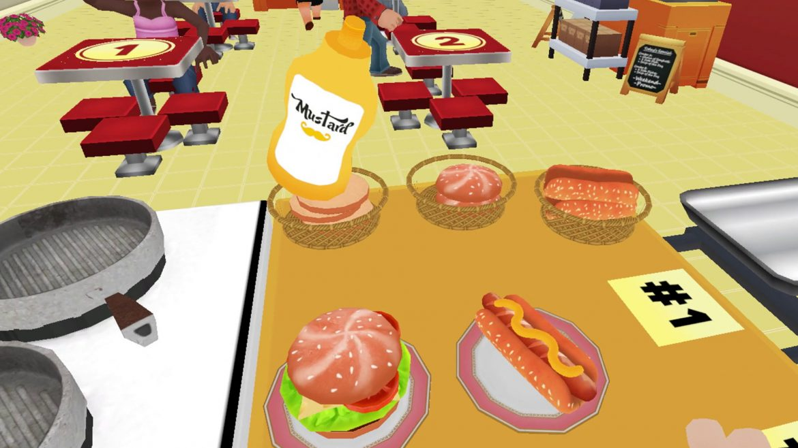
Game outline
Battle Of The Best Chef [2 Player]
Select different chefs and use your unique abilities.
Time Critical - Get as many points as possible!
Points for Cooking Speed & Precision.
Gain an Advantage - Use your abilities & sabotage your Enemy!
Highest Score Wins. It's New. It's Exciting. It's Intense.

Slide 4
TARGET MARKET
Aimed for all ages so wider market -> higher sales
Appeals to both Children & Adults.
Competitive - a pure test of skill and co-ordination

Slide 5
Unique selling POINT
2-Player Head-to-Head - Chef vs Chef.
Select Different characters w/ Special Abilities.
Compete.
Time Trial. Highest Score Wins.
Note: It’s new, it’s exciting, it’s intense.

Slide 6

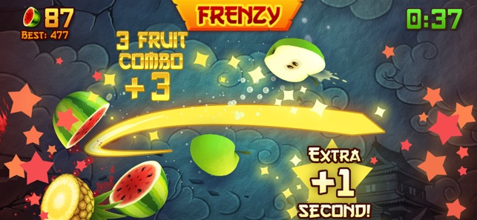
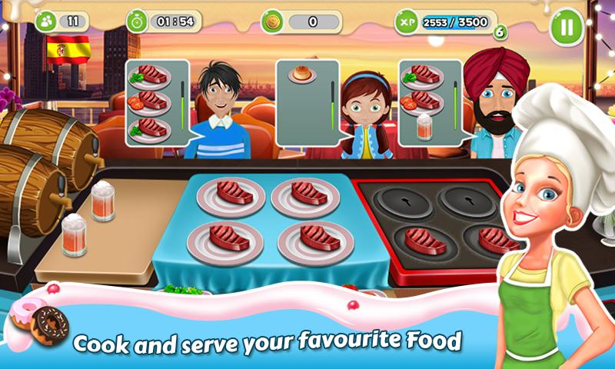
The End PRoDUCT!!

Slide 7
TECHNOLOGY STACK
2 VR headsets + accompanying controllers
PCs
Networking – for multiplayer

